Slide 1



GPS APP
Group A
GPS ASSISTED SEARCH FOR RECYCLING POINTS

Slide 2
Task
Group A
Writing an app displaying OpenStreetmap within XDK
Researching positions and types of nearby recycling station within 5km of the campus
Creating a table or database with this information
Optionally: Providing routing information using for example the TomTom API

Slide 3
Ideas for the app
Group A
Splash Screen
Page to choose the country
Map with pins for each station
List of the stations
Menubar to switch between map and list
Option to add a new station to the database

Slide 4
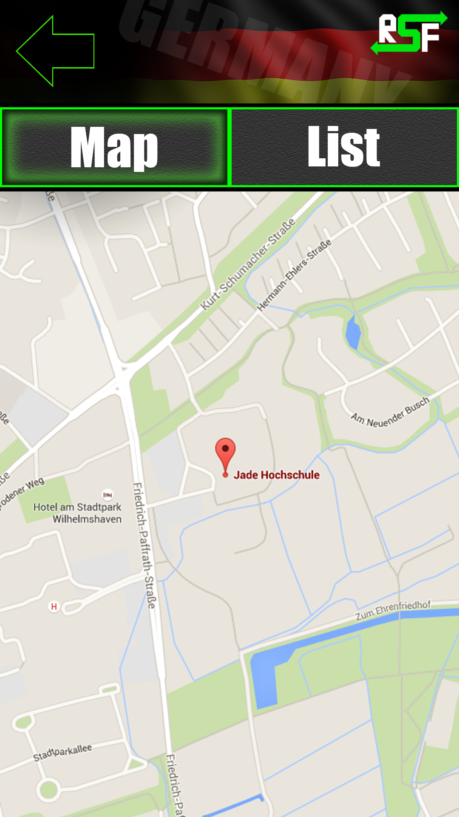

Design
Group A

Slide 5
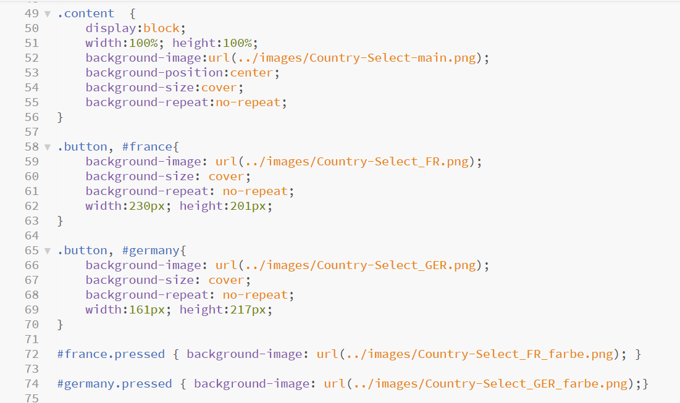
CSS Source Code
Group A

Slide 6
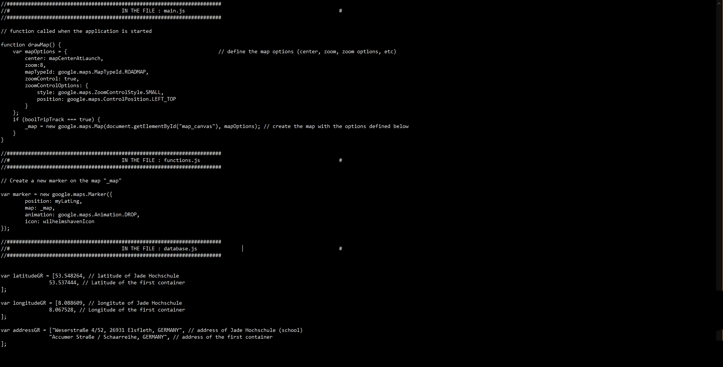
The Source Code
Group A

Slide 7
Functions of the app
Group A
Starting page to choose the country
Map with pins for ech station
Pins with different colours depending on the materials
Pop up information when selecting a pin

Slide 8


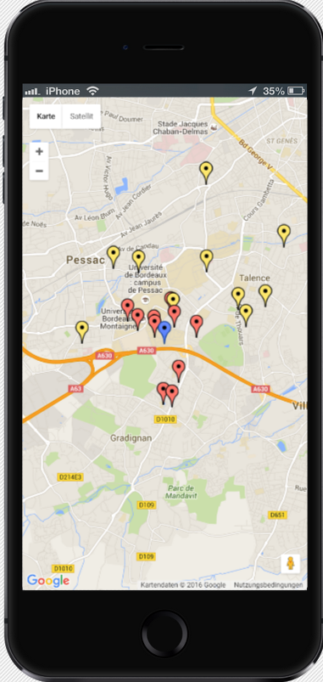
Screenshots
Group A

Slide 9
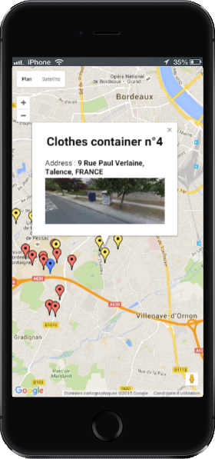
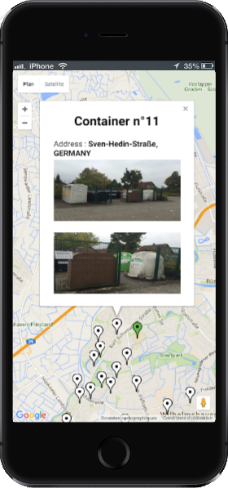
Screenshots
Group A

Slide 10
Problems
Group A
Several funtioning apps, but not all included in the final one
No menubar
No list of the stations
Can‘t add a new station
Splash screen
Go back to choosing the country

Slide 11
Conclusion
Group A
Communication
Learning by communicating in English
Problems arising from bad communication
Different opinions
Programming
New languages
Several people working on the same project

